Slide 1
dataset
총 : 84484(train: 82484, val: 1000, test: 1000)
train(CNV: 36955, DME: 11098, DRU: 8366, NOR: 26065)
val(각 250)
test(각 250)

Slide 2
CON2V
Maxpooling
Dropout(0.25)
CON2V
Maxpooling
Dropout(0.25)
Flatten
Dense
Dropout(0.5)
Dense

Slide 3
결과 - Train_Acc, Validation_Acc
 | 기존 CNN (동휘, 윤환) | 전처리 CNN | Transfer learning
img_size | 299 x 299 x 3
epochs | 100
train_acc | 0.9458 | 0.9859 | 0.7656
val_acc | 0.7290 | 0.7890 | 0.7900

Slide 4
결과 - Test_Acc
 | 기존 CNN (동휘, 윤환) | 전처리 CNN | Transfer learning
CNV | 1.0 | 0.984 | 0.8889
DME | 0.924 | 0.02
DRUSEN | 0.968 | 0.452
NORMAL | 0.996 | 0.912

Slide 5
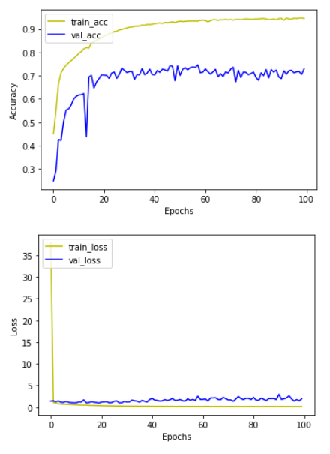
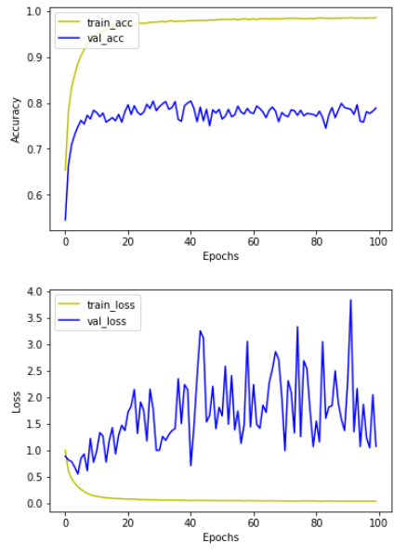
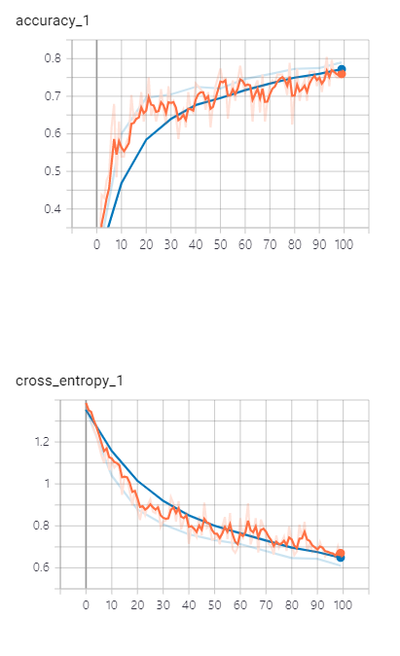
기존 CNN
(동휘,윤환)
Transfer
learning
전처리 CNN

Slide 6
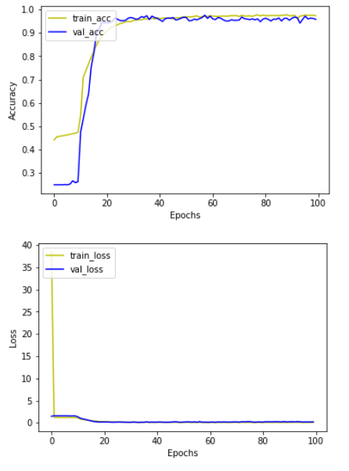
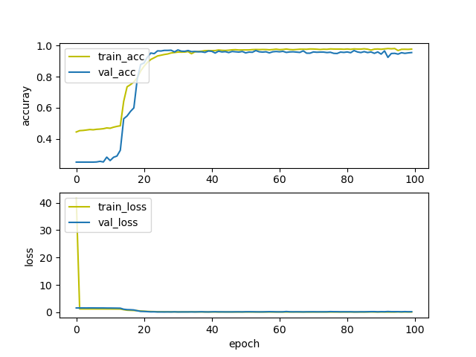
Train_Acc
Val_Acc
Test_Acc
동휘 CNN
윤환 CNN
Train Acc | 0.9734
Val Acc | 0.9580
CND | 0.948
DME | 0.592
DRUSEN | 0.444
NORMAL | 0.932

Slide 7
Val_Acc = 0.7290
Val_Acc = 0.9580

